Slide 1
Best of 2021: Research that Advanced Psychiatry and Changed our Practice Forensic Psychiatry
Prof Dr med Birgit Völlm MRCPsych DiplForPsych PhD
Medical Director, Clinic for Forensic Psychiatry
Chair, University Rostock, Germany

Slide 2
5 papers, 5 topics
New risk assessment tools
Prevalence of coercive measures in Germany
Treatment
Psychological interventions to reduce reoffending
Antipsychotic medication and reoffending
Future methods: Virtual reality
2

Slide 3
Risk assessment: What we know so far
There is an association between mental disorders and violence (odds 2 – 4 after adjustment for confounding factors; Whiting et al., 2020)
Risk assessment and risk management are important tasks of forensic psychiatrists
There is a myriad of risk assessment instruments available based on static and dynamic risk factors
Recent review on prediction of violence in inpatient forensic settings (Ramesh et al., 2018)
52 studies included, data on 6840 individuals, 9 instruments
Better accuracy for imminent tools compared with longer-term
No tool clearly superior
Longer-term accuracy moderate to poor (AUC 0.68)
HCR20 most commonly used
3

Slide 4
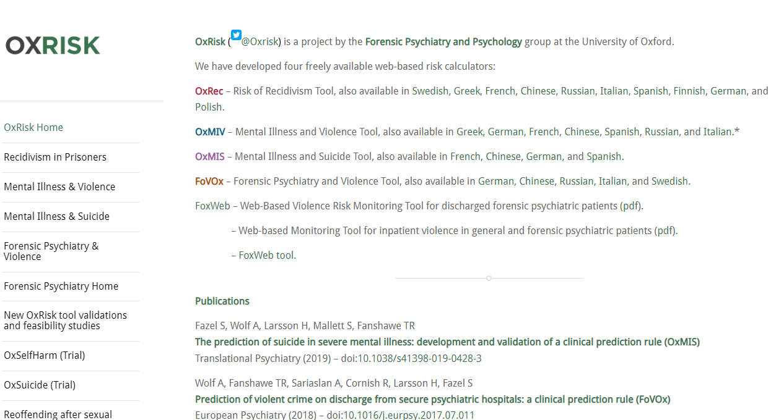
The need for new instruments
4

Slide 5
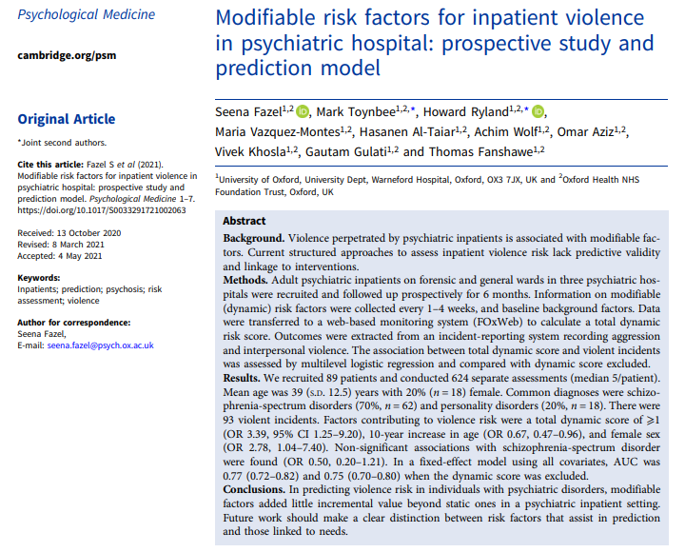
5

Slide 6
Prediction of inpatient violence
89 inpatients from forensic and general wards of three hospitals
Follow-up: Six months
Information on static and dynamic risk factors (dynamic score) collected every 1 – 4 weeks
Outcome from incident-reporting system (violent incidents)
Entered into web-based monitoring system
Patients: 80% male, 70% schizophrenia
Results:
AUC 0.77, 0.75 when dynamic score was excluded
Dynamic score added little incremental value
6

Slide 7
Change in clinical practice
Decide purpose of risk assessment
Short term or longer term violence
Prediction or risk management (interventions targeting dynamic risk factors)
Make sure instrument used is appropriate for your group of patients
Consider using new OxRisk web-based instruments for prediction
Easy to use prediction instrument could be used for stratification, e. g. for allocation of resources
SPJ instruments are recommended for risk management planning
7

Slide 8
Coercive measures: What we know so far
Violent incidents are common in in-patient psychiatric settings
Systematic review: 67% any, physical violence 50,6% in past 12 months (Liu et al., 2018)
Dutch forensic sample: 67% of staff physical violence in past 5 years (van Leeuwen & Harte, 2015)
Experience of such incidents is highly stressful and might lead to compromised patient care, absence from work and high turn-over
Duty of care towards staff and fellow patients
Non-patient related factors equally / more important than patient ones
Deescalation techniques (probably?) work
Coercive measures used to deal with violent incidents
Not enough known about prevalence of such measures in forensic mental health
Need to develop strategies to reduce both violent incidents and coercive measures
8

Slide 9
9

Slide 10
Prevalence of coercive measures
Compared coercive measures in forensic and non-forensic hospitals
Register data 8 forensic and 32 non-forensic hospitals in one federal German state, total of 1431 / 115 011 patients
Main diagnosis: forensic / non-forensic
F1: 41.6% / 27.4%
F2: 39.7% / 16.7%
F3: 2% / 26.4%
Type of measure | Prevalence forensic | Prevalence general | Cumulative duration forensic | Cumulative duration general
Mechanical restraint | 3.8% | 4.7% | 262 (27) hrs. | 38 (11) hrs.
Seclusion | 22.6% | 2.9% | 344 (91) hrs. | 32 (10) hrs.
Room confinement | 13.2% | DNA | 539 hrs. | DNA
Involuntary medication | 1.9% | 0.7% | DNA | DNA
10
Notes:
Mean MR forensic 20, seclusion 12
General 12, 11

Slide 11
Change in clinical practice
Develop (national and local) strategies to reduce coercive measures
Introduce thorough monitoring of coercive measures
Type
Frequency
Duration
Analyse data, including predictive factors (patient and non-patient)
Report statistics regularly to senior management team and share with all staff
Introduce measures:
Mandatory de-escalation training
Debriefing with patients and staff following serious incidents and coercive measures
11

Slide 12
Psychological interventions: What we know so far
Nothing works -> What works
CBT based group interventions are recommended for risk reducing interventions for offenders
Generally thought to work
But what are the key ingredients of successful interventions?
12

Slide 14
Factors in the effectiveness of treatment programmes to reduce reoffending
Metaanalysis of 70 studies, over 55 000 offenders (violence, domestic violence, sexual)
Reoffending
Offence specific recidivism: 19.4% without treatment, 13.4% with
Any violence: 21.6% without / 14.4% with
Average follow-up 66 / 65 months
Main characteristics of effective programms:
Facilitated by psychologist + co-therapist
External supervision
More than 100 hours
Group only (as opposed to group + 1:1)
Closed group
CBT based (but not psychoeduction only)
Consistency in implementation
Out-patient programmes more succesful
14

Slide 15
Change in clinical practice
Review your treatment programmes for these factors
Carefully consider success factors (evidence based!) in new treatment programmes
In summary:
RNR, Good lives, CBT
No punishment
Strength based, focus on skills
Coherent concept, shared with team and patient
Sufficient length
Closed group
Psychologist + co-therapist with external supervision
Active participation (home work, etc.)
Evaluate programme -> contribute to developing evidence base
15

Slide 16
Pharmacological treatment: What we know so far
Pharmacological treatment is the first line treatment for major mental disorders such as schizophrenia
Some evidence to suggest that some antipsychotics affect impulsivity (and reduce violent incidents, e. g. clozapine)
Clozapine might reduce reoffending compared to other antipsychotics (Mela & Depiang, 2016)
Differential effect of other antipsychotics not clear
16

Slide 17
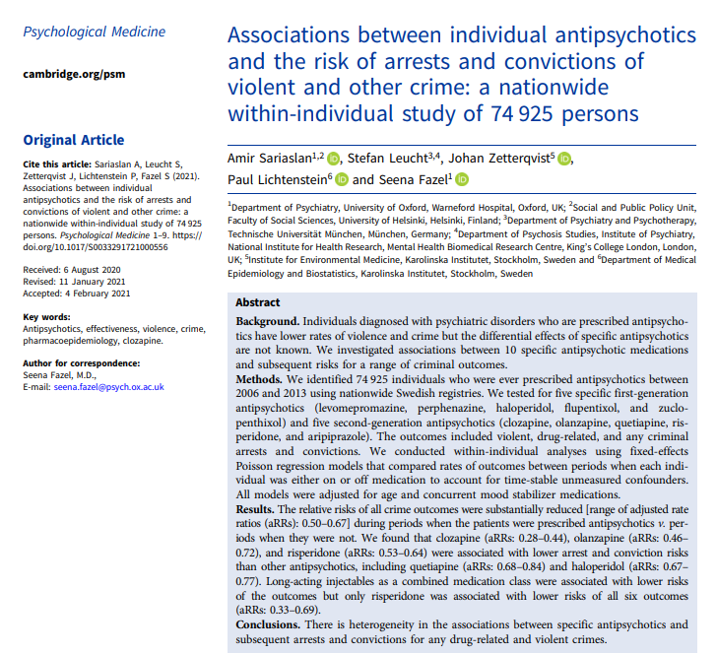

Slide 18
Associations between antipsychotics and risk of offending
Large study including nearly 75 000 patients
Design
Swedish registry study data
Within subject
2006 – 2013
5 specific first- (levomepromazine, perphanzine, haloperidol, flupentixol, zuclopentixol) and second generation antipsychotics (clozapine, olanzapine, quetiapine, risperidone, aripirazole)
Compared rates when individuals were on and off medication
Outcomes: any arrests or convictions
18

Slide 19
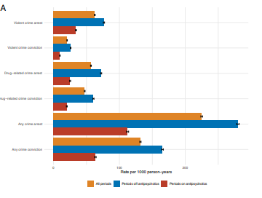
Results: Overall effect
19
Notes:
Blue off meds
Red on meds

Slide 20
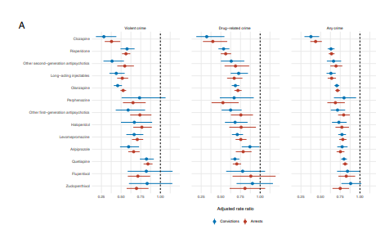
Results: Differential effects
20

Slide 21
Change in clinical practice
Importance of prescribing antipsychotic medication also for crime outcomes
Consider differential effects
Consider depot
Individualised care
Importance of adherence to medication
Educate staff accordingly
21

Slide 22
Virtual reality: What we know so far
Virtual reality is a simulated experience that can be similar or different from the real world
It is used widely in entertainment and education
Applications in psychiatry include
Research: Simulating experiences to explore interactions and underlying mechanisms
Therapy: E. g. CBT (e. g. exposure therapy), virtual reality in Alzheimer’s – emerging evidence base
Application in forensic settings less well explored
22

Slide 23
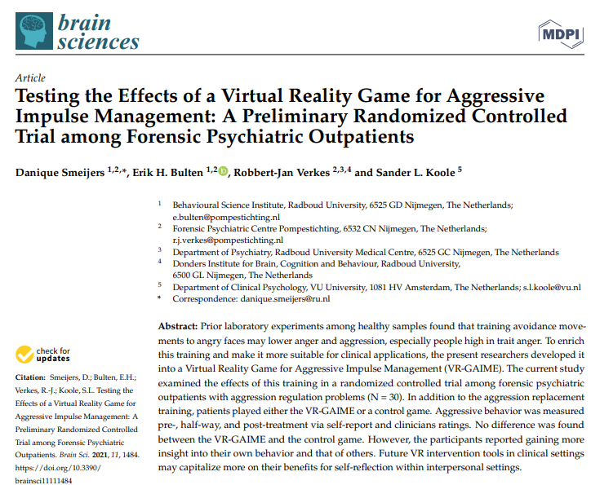
23

Slide 24
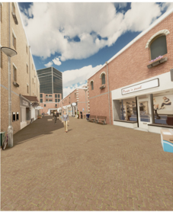
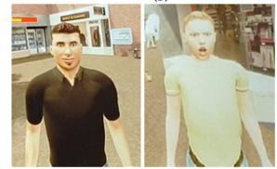
Virtual reality for aggressive impulse management
Randomised controlled trial
Forensic male outpatients with problems in regulating aggression (N = 30 – down from 46) in Netherlands
Virtual Reality Game for Aggressive Impulse Management (and control game), five weekly sessions
24
Notes:
Shopping street, courier collecting parcels, two types of avatars, lean forward or back

Slide 25
Virtual reality for aggressive impulse management, continued
Follow-up 12 weeks
Outcome
Self- and clinician-rated aggression
Participant evaluation of the game and added value
Results:
No differences in main outcome
Participants enjoyed the game
Thought it helped them gaining more insight into their own behaviour and that of others
25
Notes:
Social Dysfunction and Aggression Scale (SDAS) (self and other)
Behavioral Inhibition System/Behavioral Activation System (BIS/BAS) (self)
Reactive Proactive Questionnaire (RPQ) (self)
Aggression Questionnaire (AQ) (self)
State Trait Anger Scale (STAS) (self)
Discrete Emotions Questionnaire (DEQ) (self)
Virtual voodoo doll task (VVDT)
Hostile Interpretation Bias Task (HIBT)

Slide 26
Changes in clinical practice
Virtual reality should be further developed in forensic settings
Alternative / Addition to methods targeting conscious thoughts and processes in motivated individuals
Improve validity to real life situations
Target specific groups of patients
26

Slide 27
Thanks for your attention!
27

